Slide 1
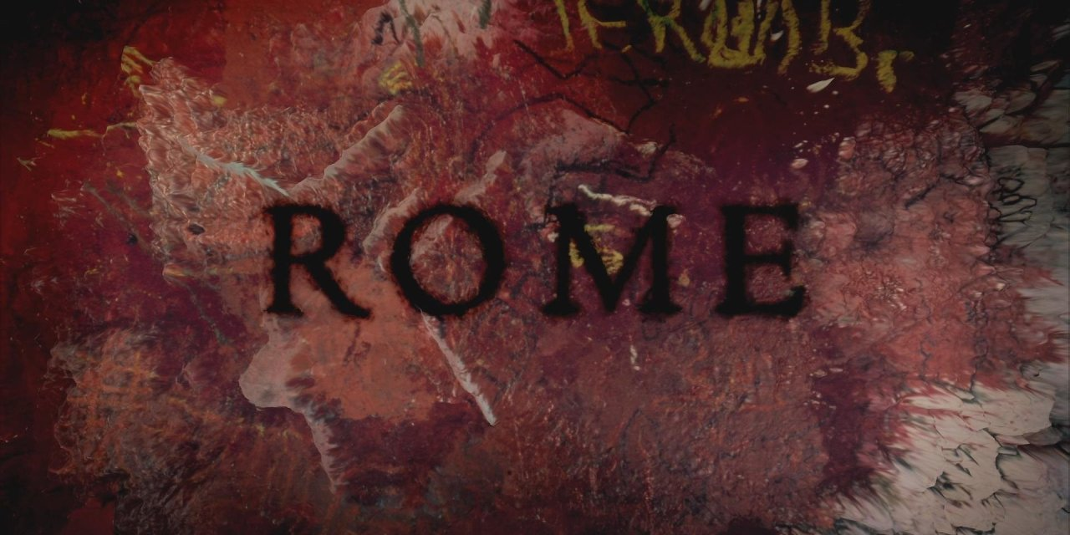
Ancient Rome
SPQR
The civilisation that shapes us today
The Civilisation that shapes us today

Slide 2
Salve!

Slide 3
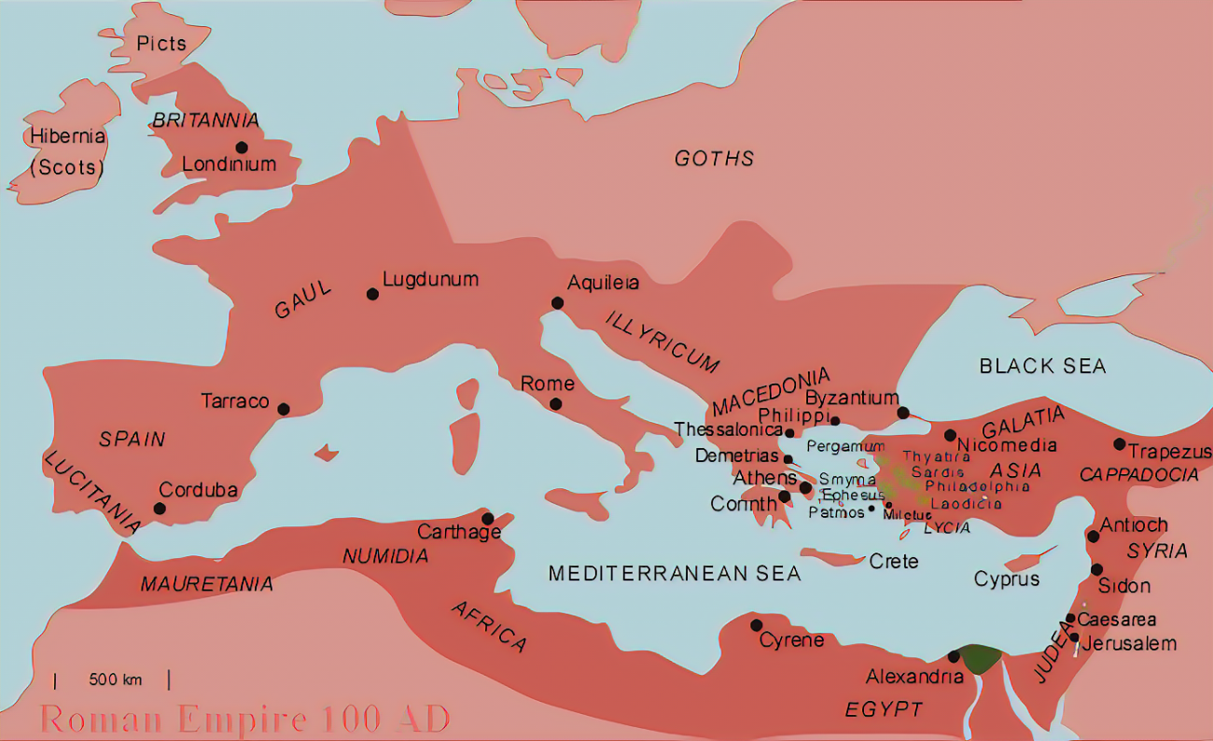
The Roman Empire

Slide 4
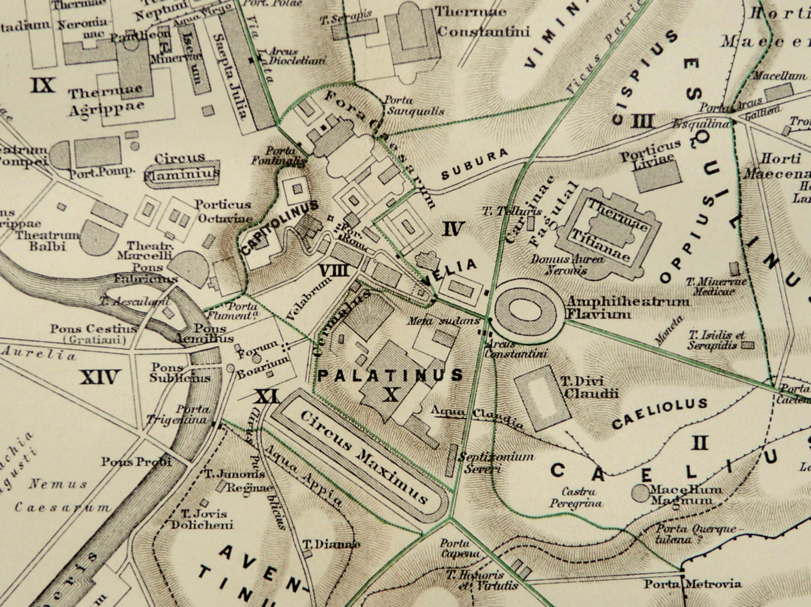
Rome – Seven Hillls

Slide 5
Key dates
Founding of Rome, 753 BC by Romulus and Remus, on Palatine Hill. Descended from Aeneas (Troy)
Kings (7) Romulus, Numa Pompilius, Tullus Hostilius, Ancus Marcius, Priscus, Servius Tullius, Tarquin
Republic, 509 BC, governed by 2 Consuls (1-year term), and Senate. NB Punic Wars 264-146 BC
Empire. Caesar ceased in 44 BC, civil war, Augustus 27 BC (Key period for this presentation)
Fall of Rome 476 AD NB Alaric took Rome in 410 AD (>Byzantium, Constantine Christian 312 AD) Holy Roman Empire? (>Hapsburgs 1806)

Slide 6
A few histories to get you started
Edward Gibbon, Decline and Fall of the Roman Empire, Arnold Toynbee. Mankind and Mother Earth: A Narrative History of the World. New York: Oxford University Press. 1976, Andrew Marr, History of the World
In chronological order: Sallust (Gaius Sallustius Crispus), Catiline Conspiracy, Jugurthine War, Histories (only some of the latter survive); Caesar, Commentarii de Bello Gallico; Marcus Tullius Cicero, De Re Publica…; Livy (Titus Livius), Ad Urbe Condita; Tacitus (Publius Gaius Cornelius Tacitus), The Annal and Histories, (considered to be the greatest historian of the times); Suetonius (Gaius Suetonius Tranquilus), The Twelve Caesars.

Slide 7
Rome expansion – why and how
Why?
Need for food (wheat, olive oil), minerals…
Need for slaves – domestic, agriculture, mines, galleys
How
Incredible military machine
All citizens served 6, later, 20 years. Auxiliaries (non-citizen natives) enlisted for 25 years.
Mainly infantry (>Roman roads!) with some cavalry flanking support
Training, tactics, manoeuvres (only Hannibal did better – for a while)

Slide 8
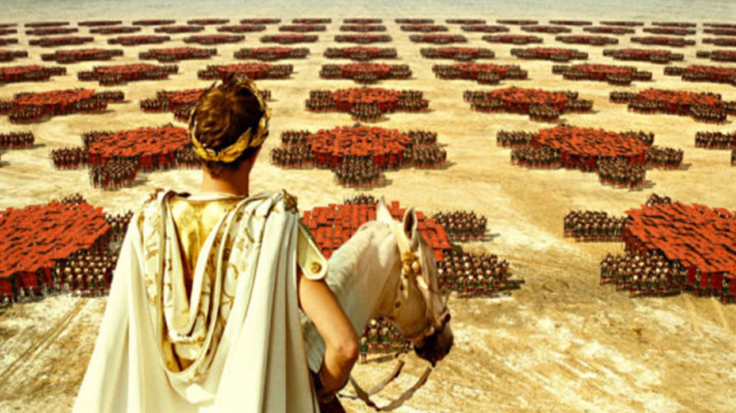

Slide 9
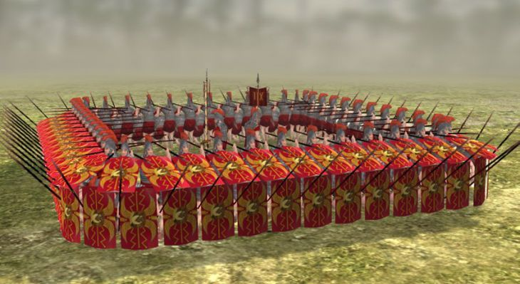
Military tactics, manoeuvres

Slide 10
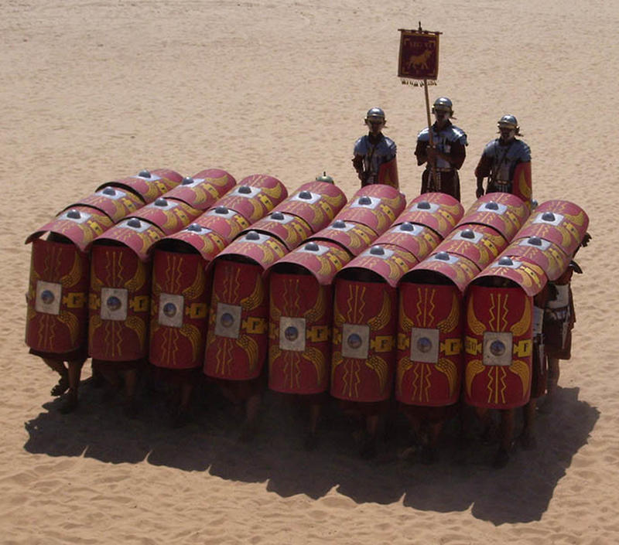

Slide 11
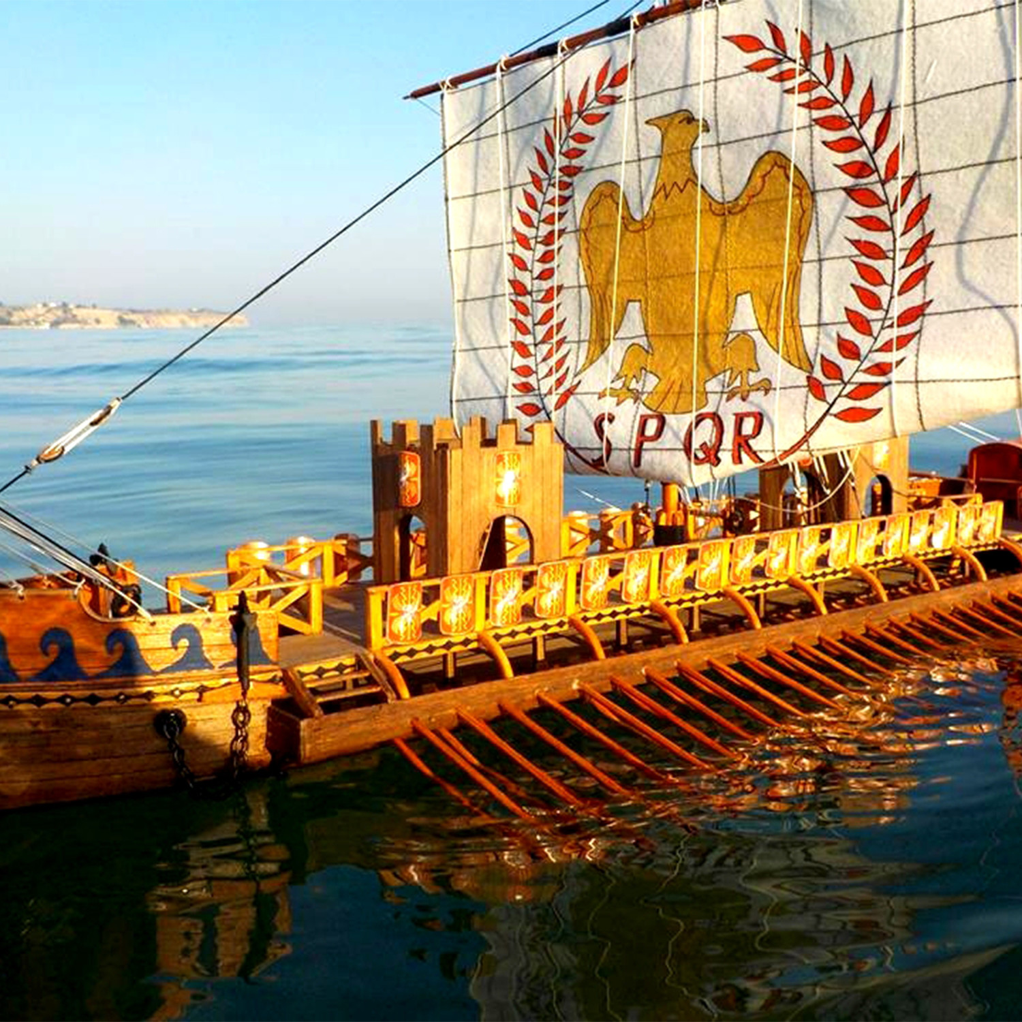

Slide 12
Rome Centrefold - Drama
Shakespeare: Julius Caesar, Anthony and Cleopatra
Movies/TV (some have several versions)
Julius Caesar, Anthony and Cleopatra, Fall of the Roman Empire, Spartacus, Gladiator, I Claudius, Centurion, Hannibal, Quo Vadis, Caligula, Nero, Up Pompei..
Opera by Handel

Slide 13
Main characters, events
1st Triumvirate 60BC – Pompey, Caesar, Crassus. Split after Crassus’ death. And Caesar marched on Rome, crossing Rubicon 49BC, then civil war. Pompey beaten at Pharsalus, beheaded in Egypt. Note: Caesar populist.
44 BC Caesar assassinated
2nd Triumvirate 43 BC – Marc Anthony, Lepidus, Octavian. Civil war against Brutus, Cassius (“lean and hungry). Lepidus ousted and exiled.
Civil war Octavian vs M. Anthony and Cleo – defeated at Actium 31 BC, suicide 30 BC. Octavian > Augustus sole ruler 31 BC > Emperor.

Slide 14
Caesar - De bello Gallico
Julius Caesar wrote (or dictated) extensive military histories but almost nothing remains of his speeches.
His texts are a model of brevity and clarity but not lacking in drama. His report of the capture of Vercingetorix, leader of the Gauls, after the battle/siege at Alisia is given in the View Notes here.
Caesar made enemies of the rich patricians in the Senate and they decided to assassinate him. Among the assassins was his boyhood friend, Brutus. Reportedly, Caaesar turned to him and said “et tu, Brute?” but Suetonius wrote the quote as καὶ σὺ τέκνον (You too, my child ).
Notes:
Caesar De Bello Gallico Book 7
[Towards the end of the siege of Alesia where the whole army of the Gauls has made a stand, Caesar arrives in the field.]
7.88 His arrival being known from the colour of his robe, and the troops of cavalry, and the cohorts which he had ordered to follow him being seen, as these low and sloping grounds were plainly visible from the eminences, the enemy join battle. A shout being raised by both sides, it was succeeded by a general shout along the ramparts and whole line of fortifications. Our troops, laying aside their javelins, carry on the engagement with their swords. The cavalry is suddenly seen in the rear of the Gauls; the other cohorts advance rapidly; the enemy turn their backs; the cavalry intercept them in their flight, and a great slaughter ensues…. The besieged, beholding from the town the slaughter and flight of their countrymen, despairing of safety, lead back their troops from the fortifications. A flight of the Gauls from their camp immediately ensues on hearing of this disaster, and had not the soldiers been wearied by sending frequent reinforcements, and the labour of the entire day, all the enemy's forces could have been destroyed. Immediately after midnight, the cavalry are sent out and overtake the rear, a great number are taken or cut to pieces, the rest by flight escape in different directions to their respective states. Vercingetorix, having convened a council the following day, declares, "That he had undertaken that war, not on account of his own exigences, but on account of the general freedom; and since he must yield to fortune, he offered himself to them for either purpose, whether they should wish to atone to the Romans by his death, or surrender him alive. Ambassadors are sent to Caesar on this subject. He orders their arms to be surrendered, and their chieftains delivered up. He seated himself at the head of the lines in front of the camp, the Gallic chieftains are brought before him. They surrender Vercingetorix, and lay down their arms. Reserving the Aedui and Arverni, [to try] if he could gain over, through their influence, their respective states, he distributes one of the remaining captives to each soldier, throughout the entire army, as plunder.

Slide 15
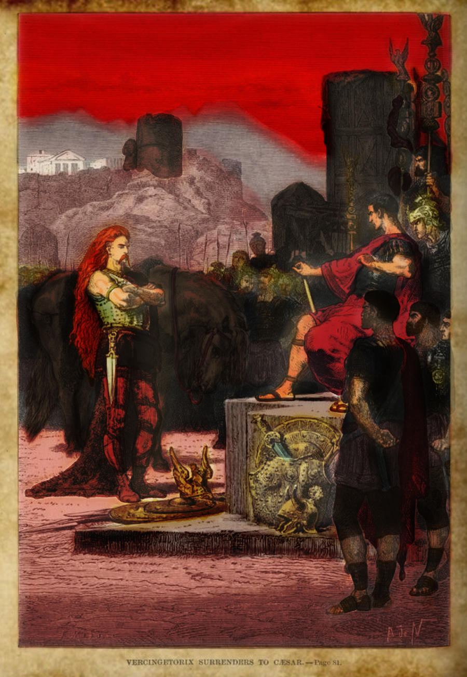
Surrender of Vercingetorix

Slide 16
Caesar De Bello Gallico Book 7
[Towards the end of the siege of Alesia where the whole army of the Gauls has made a stand, Caesar arrives in the field.]
7.88 His arrival being known from the colour of his robe, and the troops of cavalry, and the cohorts which he had ordered to follow him being seen, as these low and sloping grounds were plainly visible from the eminences, the enemy join battle. A shout being raised by both sides, it was succeeded by a general shout along the ramparts and whole line of fortifications. Our troops, laying aside their javelins, carry on the engagement with their swords. The cavalry is suddenly seen in the rear of the Gauls; the other cohorts advance rapidly; the enemy turn their backs; the cavalry intercept them in their flight, and a great slaughter ensues…. The besieged, beholding from the town the slaughter and flight of their countrymen, despairing of safety, lead back their troops from the fortifications. A flight of the Gauls from their camp immediately ensues on hearing of this disaster, and had not the soldiers been wearied by sending frequent reinforcements, and the labour of the entire day, all the enemy's forces could have been destroyed. Immediately after midnight, the cavalry are sent out and overtake the rear, a great number are taken or cut to pieces, the rest by flight escape in different directions to their respective states. Vercingetorix, having convened a council the following day, declares, "That he had undertaken that war, not on account of his own exigences, but on account of the general freedom; and since he must yield to fortune, he offered himself to them for either purpose, whether they should wish to atone to the Romans by his death, or surrender him alive. Ambassadors are sent to Caesar on this subject. He orders their arms to be surrendered, and their chieftains delivered up. He seated himself at the head of the lines in front of the camp, the Gallic chieftains are brought before him. They surrender Vercingetorix, and lay down their arms. Reserving the Aedui and Arverni, [to try] if he could gain over, through their influence, their respective states, he distributes one of the remaining captives to each soldier, throughout the entire army, as plunder.

Slide 17
Famous speeches
Shakespeare’s Marc Anthony [see notes in View]
American Rhetoric: Movie Speech from Julius Caesar - Marc Antony Addresses Romans on the Death of Julius Caesar Click on the Movie Speech above to access the speech on YouTube in a new window.

Slide 18
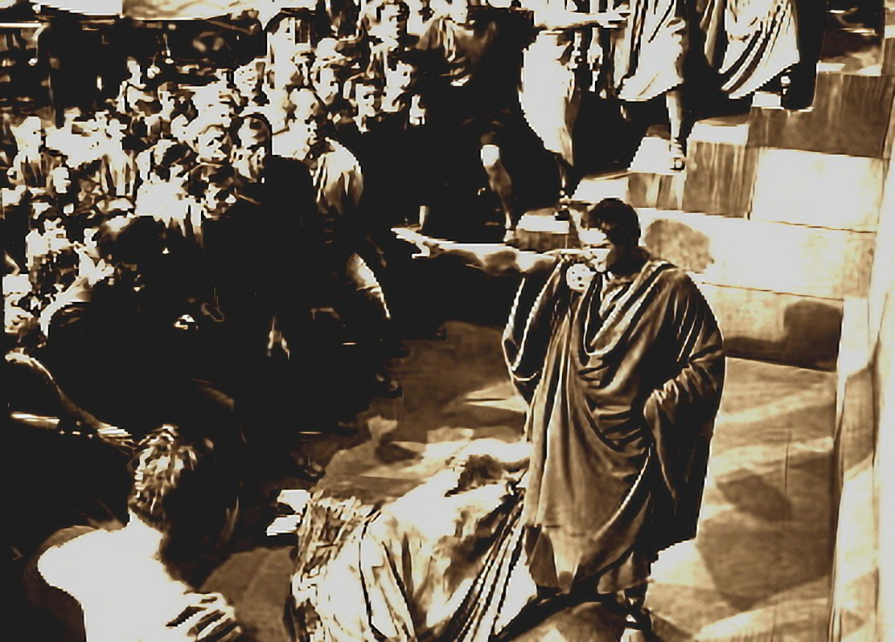
Marc Anthony - Friends, Romans and Countrymen
Text in View Notes page

Slide 19
Friends, Romans, countrymen, lend me your ears; I come to bury Caesar, not to praise him. The evil that men do lives after them; The good is oft interred with their bones; So let it be with Caesar.
The noble Brutus Hath told you Caesar was ambitious: If it were so, it was a grievous fault, And grievously hath Caesar answer'd it. Here, under leave of Brutus and the rest-- For Brutus is an honourable man; So are they all, all honourable men—Come I to speak in Caesar's funeral. He was my friend, faithful and just to me: But Brutus says he was ambitious; And Brutus is an honourable man.
He hath brought many captives home to Rome Whose ransoms did the general coffers fill: Did this in Caesar seem ambitious? When that the poor have cried, Caesar hath wept: Ambition should be made of sterner stuff: Yet Brutus says he was ambitious; And Brutus is an honourable man. You all did see that on the Lupercal I thrice presented him a kingly crown, Which he did thrice refuse: was this ambition? Yet Brutus says he was ambitious; And, sure, he is an honourable man.
I speak not to disprove what Brutus spoke, But here I am to speak what I do know. You all did love him once, not without cause: What cause withholds you then, to mourn for him? O judgment! thou art fled to brutish beasts, And men have lost their reason. Bear with me; My heart is in the coffin there with Caesar, And I must pause till it come back to me.

Slide 20
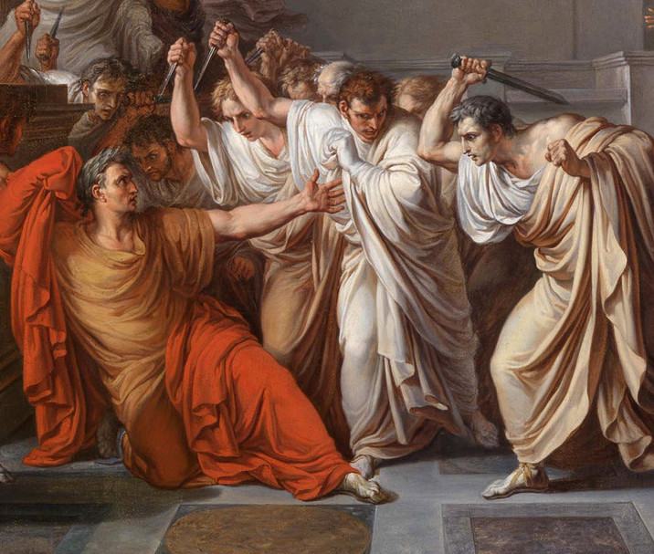
Et tu, Brute?

Slide 21
Others
Cicero. Lawyer, politician. Great orator – see later) . Cicero had championed a return to traditional republican government. Became enemy of Marc Anthony, was proscribed as an enemy of the state by the 2nd Triumvirate and executed in 43 BC.
Clodius, (93–52 BC) populist politician and street agitator. Although patrician he contrived to be adopted by an obscure plebeian, so that he could be elected tribune (and eventually exile Cicero). Led scandalous lifestyle, violating the sanctity of a religious rite reserved solely for women, purportedly with the intention of seducing Caesar’s wife,Pompeia. Killed following a gang fight.
Catiline 108-69 BC. Attempted to overthrow the Republic. Acquitted several times, including one for the charge of adultery with a Vestal Virgin. Later defeated and killed in an uprising.

Slide 22
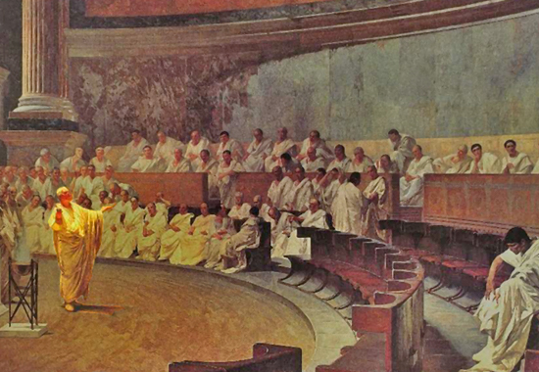
Cicero 4th Catiline Speech to the Senate
O tempora, o mores
Catalina executed shortly after – see text in View Notes Page.
Notes:
Cicero 4th Catiline Speech to the Senate (R. Harris from Cicero’s own text, recorded by Tiro)
‘How much longer, Catilina, will you try our patience? How much longer must we put up with your madness?
‘Is there no end to your arrogance? Don’t you understand that we know what you’re up to? Don’t you appreciate that your conspiracy is uncovered? Do you think there’s a man among us who doesn’t know what you did last night – where you were, who came to your meeting, and what you agreed?’
‘Oh, what times are these, and oh, what morals! [O tempora, o mores]
“The senate knows everything, the consul knows everything, and yet – this man is still alive! Alive? Not just alive, gentlemen. He attends the senate! He takes part in our debates. He listens to us. He watches us – and all the time he’s deciding who he’s going to kill! Is this how we serve the republic – simply by sitting here, hoping it’s not going to be us? How very brave we are! It’s been twenty days since we voted ourselves the authority to act. We have the sword – but we keep it sheathed! You ought to have been executed immediately, Catilina. Yet still you live. And as long as you live, you don’t give up your plotting – you increase it!’
‘Let’s go over the events of last night. You went to the street of the scythe-makers – I’ll be precise – to the house of Marcus Laeca. There you were joined by your criminal accomplices. Well, do you deny it? Why the silence? If you deny it, I’ll prove it. In fact, I see some of those who were with you here in the senate. In heaven’s name, where in the world are we? What country is this? What city are we living in? Here, gentlemen – here in our very midst, in this, the most sacred and important council in the world, there are men who want to destroy us, destroy our city, and extend that destruction to the entire world! ‘You were at the house of Laeca, Catilina. You carved up the regions of Italy. You decided where you wanted each man to go. You said you would go yourself as soon I was dead. You chose parts of the city to be burnt. You sent two men to kill me. So I say to you, why don’t you finish the journey you have begun? At long last really leave the city! The gates are open. Be on your way! The rebel army awaits its general.
If I give an order for you to be killed, there will remain in the state the rest of the conspirators. But if, as I have long been urging, you leave the city, you will drain from it that flood of sewage that for you are your accomplices and for the rest of us our deadly enemies. Well, Catilina? What are you waiting for? What’s left that can give you any pleasure in this city now? Beyond that conspiracy of ruined men, there isn’t a single person who doesn’t fear you, not one who doesn’t hate you.’
Let the traitors, then, depart!’
‘Go forth, Catilina, to your iniquitous and wicked war, and so bring sure salvation to the republic, disaster and ruin on yourself, and destruction to those who have joined you. Jupiter, you will protect us, and visit on these evil men, alive or dead, your punishment eternal!’

Slide 23
Cicero 4th Catiline Speech to the Senate (R. Harris from Cicero’s own text, recorded by Tiro)
‘How much longer, Catilina, will you try our patience? How much longer must we put up with your madness?
‘Is there no end to your arrogance? Don’t you understand that we know what you’re up to? Don’t you appreciate that your conspiracy is uncovered? Do you think there’s a man among us who doesn’t know what you did last night – where you were, who came to your meeting, and what you agreed?’
‘Oh, what times are these, and oh, what morals! [O tempora, o mores]
“The senate knows everything, the consul knows everything, and yet – this man is still alive! Alive? Not just alive, gentlemen. He attends the senate! He takes part in our debates. He listens to us. He watches us – and all the time he’s deciding who he’s going to kill! Is this how we serve the republic – simply by sitting here, hoping it’s not going to be us? How very brave we are! It’s been twenty days since we voted ourselves the authority to act. We have the sword – but we keep it sheathed! You ought to have been executed immediately, Catilina. Yet still you live. And as long as you live, you don’t give up your plotting – you increase it!’
continued over page

Slide 24
Continued from last page
‘Let’s go over the events of last night. You went to the street of the scythe-makers – I’ll be precise – to the house of Marcus Laeca. There you were joined by your criminal accomplices. Well, do you deny it? Why the silence? If you deny it, I’ll prove it. In fact, I see some of those who were with you here in the senate. In heaven’s name, where in the world are we? What country is this? What city are we living in? Here, gentlemen – here in our very midst, in this, the most sacred and important council in the world, there are men who want to destroy us, destroy our city, and extend that destruction to the entire world! ‘You were at the house of Laeca, Catilina. You carved up the regions of Italy. You decided where you wanted each man to go. You said you would go yourself as soon I was dead. You chose parts of the city to be burnt. You sent two men to kill me. So I say to you, why don’t you finish the journey you have begun? At long last really leave the city! The gates are open. Be on your way! The rebel army awaits its general.
If I give an order for you to be killed, there will remain in the state the rest of the conspirators. But if, as I have long been urging, you leave the city, you will drain from it that flood of sewage that for you are your accomplices and for the rest of us our deadly enemies. Well, Catilina? What are you waiting for? What’s left that can give you any pleasure in this city now? Beyond that conspiracy of ruined men, there isn’t a single person who doesn’t fear you, not one who doesn’t hate you.’
Let the traitors, then, depart!’
‘Go forth, Catilina, to your iniquitous and wicked war, and so bring sure salvation to the republic, disaster and ruin on yourself, and destruction to those who have joined you. Jupiter, you will protect us, and visit on these evil men, alive or dead, your punishment eternal!’

Slide 25
Some crime faction…
Stephen Saylor, Gordianus Series, (16 books). 1st century BC through to Caesar. Gordianus, the Finder is a serious detective, but the novels are amusing in parts. Gordianus interacts with Sulla, Cicero, Marcus Crassus, Catullus, Catiline, Pompey, Julius Caesar, Quintus Sertorius, and Marc Antony. Frees and marries his slave, Bethesda.
Lindsey Davis, Falco Series (20 books), followed by Flavia Alba (Falco’s adopted daughter) Series (9 books) and others. Set in time of Vespasian (1st Century AD) i.e., post Claudius, Augustus, Tiberius, Caligula and co. Falco is a successful “finder” (detective), solving mainly murders. He rises from the Plebian to the Equestrian rank, marries the Aristocratic and very smart Helena Justina. Funny.

Slide 26
Some modern faction
Robert Graves, I Claudius and Claudius the God. Classics by the master.
Robert Harris Cicero Trilogy The Cicero Trilogy, Amazon (3 books, last volume 2021 – more to come?). Based mainly on Cicero’s recorded speeches.
Conn Igulden Emperor Series, Amazon (5 books), focussed on Caesar, passing from the Republic, inc. Sulla’s Dictatorship, the triumvirate and on to Octavian wreaking revenge. Meet Brutus, Marc Anthony and the usual characters with lean and hungry looks. Pompey is past his best. Bump into/off Mithridates, Vercingetorix, Spartacus and the lovely Cleopatra.

Slide 27
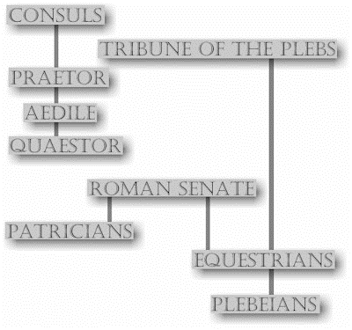
Structure of Republic -SPQR

Slide 28
How did it work?
The republic was run by the Senate. The senate passed all laws and collected all taxes. All members of the Senate were of the Patrician or wealthy landowner class.
Two consuls presided over the Senate, and also controlled the army (legions). Senator were selected by the Consuls for life from the Patrician upper class. Consul were elected by a majority of the popular vote (in person on the Field of Mars).
A college of ten tribunes of the plebs acted as a check on the authority of the senate and annual magistrates, holding the power to veto legislation.

Slide 29
Laws
Roman law is the legal system of ancient Rome, over 1,000 years from the Twelve Tables (c. 449 BC), to the Corpus Juris Civilis (AD 529) of Justinian, Byzantium.
Roman law is the basis for civil law, the widely used legal system today. (Civil=Roman based, cf Common Law).The historical importance of Roman law is reflected by the continued use of Latin legal terminology in many legal systems influenced by it, including common law.
Most European legal systems based on Justinian’s Digest and Institutes, e.g. Napoleonic Code, much of Scots Law…) (see RW Lee, Elements of Roman Law)

Slide 30
Means of execution
Poena cullei -For parricide - victim put into a sack with a monkey, a snake, a dog, and a rooster, and thrown into the Tiber..
Thrown from the Tarpeian Rock (cliff on the southern end of Capitoline Hill).
Strangulation
Burned alive
Decimation. Military punishment. Every 10th man was beaten to death by the other 9 members of his cohort.
Molten gold poured down the throat
Death by parasites. Mainly Christian victims put in a barrel, smeared with honey to attracted insects
Boiling in oil
Crucifixion
Damnatio ad Bestias. Victims thron to wild animals in arena.

Slide 31
Latin language
Basis for modern French, Italian, Spanish, Portuguese, Romanian, Romanish (Swiss) and important inputs to English
V. important in church (esp Catholic), law, biology, botany,
Many common abbreviations in English from Latin (short versions):
AD, AI, AM, ca, cap, cf, cv, cwt, dv, dg, et al, etc, eg, ibid, id, ia, lbs, LL.B, MA
Adeste fideles.., Gloria in excelsis…, Ave Maria… Pater noster…
Et cetera

Slide 32
Roman names
Typical Roman names of the late Republic had three parts (the "tria nomina"). Example: Gaius Iulius Caesar where:
Gaius is a praenomen ("given name", used in childhood),
Iulius is a nomen ("gens or clan name", plural nomina), and
Caesar is a cognomen ("family name within a gens", plural cognomina). (After Caesar his name became a title)
Some names had no cognomen, but in other cases a second cognomen, (called an agnomen), was added, by the individual or as an honorific e.g. Scipio became Scipio Africanus after demolish the Carthiginian, Pompey became Pompeius Maximus after defeat of Mithridates….).

Slide 33
Religion
Official state religion multitheistic: Jupiter, Ceres, Mars, Neptune, Venus, Apollo Juna, Diana, Minerva, Neptune, Vesta, Vulcan…
Reading the augurs, mainly after a animal sacrifice was a key element of various ceremonies.
Role of Pontifex Maximus was the chief high priest. V. important position, held By Caesar while consul.
Rome open to other religions but Christianity challenge the civil power (despite “Render unto Caesar what is Caesar’s..)

Slide 34
Themes & thoughts
Has the transition from republic to empire something to tell us today (democracy to autocracy)?
Did the early emperors see themselves as necessary to maintain order (Plato’s Philosopher kings?) or were they just out to make money?
What were the key issues? Slavery? Poverty alleviation (Populares, inc.Gracchi bros. vs optimates, ie traditionalists)?

Slide 35
Vale!

